Slide 1

Karnaugh Maps for Simplification
Dr Md. Ali Hossain

Slide 2
Karnaugh Maps
Boolean algebra helps us simplify expressions and circuits
Karnaugh Map: A graphical technique for simplifying a boolean expression into either form:
  Minimal Sum of Products (MSP)
  Minimal Product of Sums (MPS)
Goal of the simplification.
  There are a minimal number of product/sum terms
  Each term has a minimal number of literals/variables

Slide 3
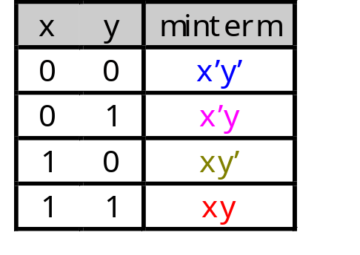
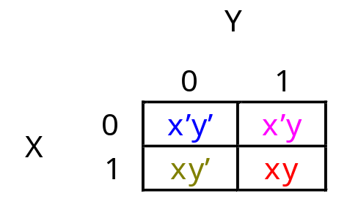
Karnaugh Maps (K-Map)
A two-variable function has four possible minterms. We can re-arrange these minterms into a Karnaugh map
Now we can easily see which minterms contain common literals
K-map squares are labeled so that the adjacent squares differ in one variable

Slide 4
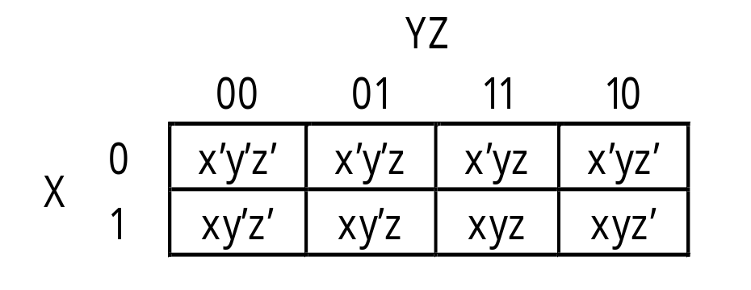
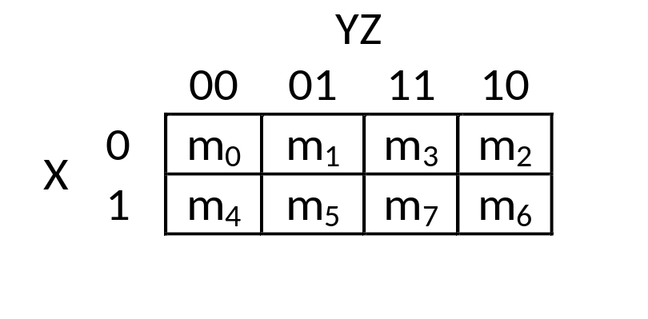
A Three-Variable Karnaugh Map
For a three-variable expression with inputs x, y, z, the arrangement of minterms is more tricky:
Similarly, in three variable K-map, adjacent squares differ in one variable only

Slide 5
A Four-Variable Karnaugh Map
A four-variable expression with inputs X, Y, Z and P, the arrangement of minterms is more tricky:
Attention: Adjacent squares differ in one variable only.
K-map is suitable up to 2, 3, 4, 5 and 6 variables. K-map can be more difficult to manage with more variables.
 | Z’P’ | Z’P | ZP | ZP’
X’Y’ | X’Y’Z’P’ | X’Y’ Z’P | X’Y’ ZP | X’Y’ ZP’
X’Y | X’Y Z’P’ | X’YZ’P | X’YZP | X’YZP’
XY | XYZ’P’ | XYZ’P | XYZP | XYZP’
XY’ | XY’ Z’P’ | XY’ Z’P | XY’ ZP | XY’ZP’

Slide 6
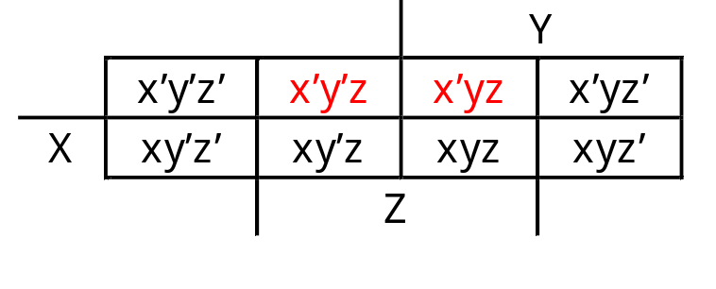
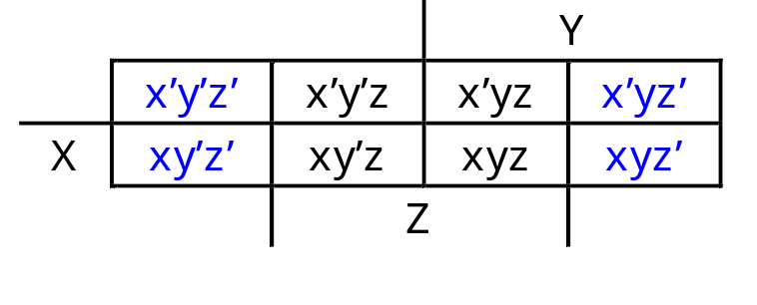
Why the funny ordering?
With this ordering, any group of 2, 4 or 8 adjacent squares on the map contains common literals that can be factored out
“Adjacency” includes wrapping around the left and right sides:
We’ll use this property of adjacent squares to do our simplifications.
x’y’z + x’yz
= x’z(y’ + y)
= x’z • 1
= x’z
  x’y’z’ + xy’z’ + x’yz’ + xyz’
  = z’(x’y’ + xy’ + x’y + xy)
  = z’(y’(x’ + x) + y(x’ + x))
  = z’(y’+y)
  = z’

Slide 7
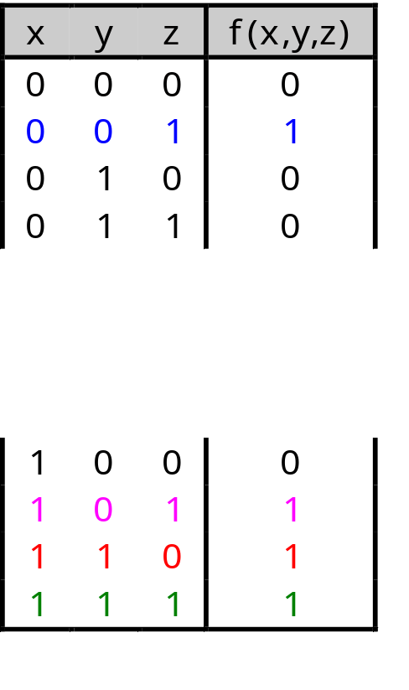
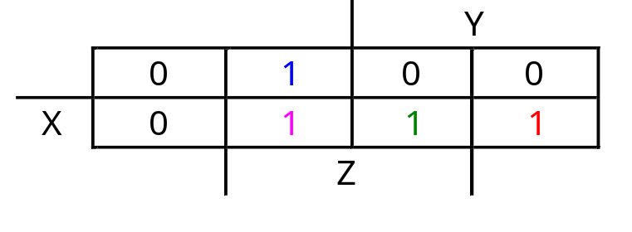
K-maps From Truth Tables
We can fill in the K-map directly from a truth table
  The output in row i of the table goes into square m_{i} of the K-map
  Remember that the rightmost/output columns of the K-map are “switched”

Slide 8
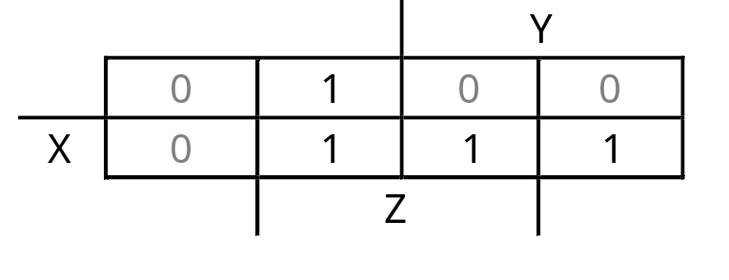
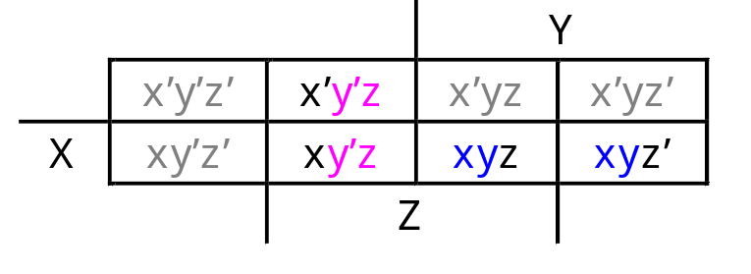
Simplification from K-map
We can find the minimal SoP expression
  Each rectangle corresponds to one product term
  The product is determined by finding the common literals in that rectangle
y’z
xy
F(x,y,z)= y’z + xy

Slide 9
For the Simplest Result
Make the largest rectangles as possible, to minimize the number of products in the final expression.
Rectangles can be overlapped, if that makes them larger.

Slide 10
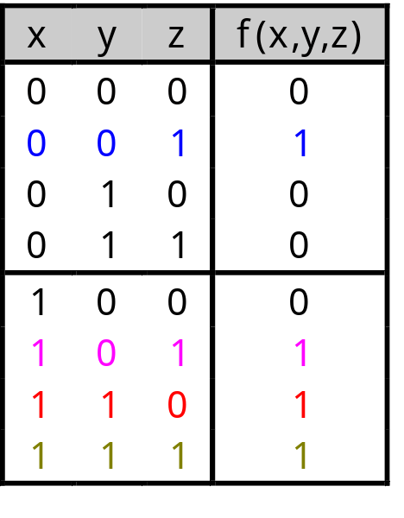
K-map Simplification of SoP Expressions
Let’s consider simplifying f(x,y,z) = xy + y’z + xz
You should convert the expression into a sum of minterms form,
  The easiest way to do this is to make a truth table for the function, and then read off the minterms
  You can either write out the literals or use the minterm shorthand
Here is the truth table and sum of minterms for our example:
f(x,y,z) = x’y’z + xy’z + xyz’ + xyz
= m₁ + m₅ + m₆ + m₇

Slide 11
For the Simplest Result
Make the largest rectangles as possible, to minimize the number of products in the final expression.
Rectangles can be overlapped, if that makes them larger.

Slide 12
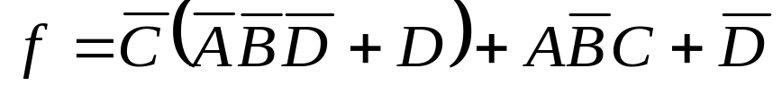
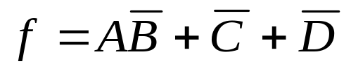
Filling K-map From Boolean Expression
Convert the Boolean expression into SOP form.
For each product term in SOP expression place 1 in every squares whose label are the same combination of input variables.
Example:
 | C’D’ | C’D | CD | CD’
A’B’ | 1 | 1 | 0 | 1
A’B | 1 | 1 | 0 | 1
AB | 1 | 1 | 0 | 1
AB’ | 1 | 1 | 1 | 1

Slide 13
I don’t care about K-map

Slide 14
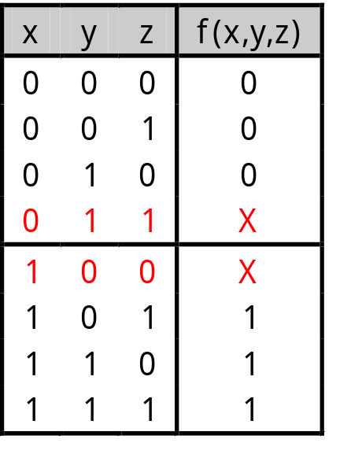
Don’t Care Conditions
You don’t always need all 2^{n} input combinations in an n-variable function
  If you can guarantee that certain input combinations never occur
  If some outputs aren’t used in the rest of the circuit
We mark don’t-care outputs in truth tables and K-maps with Xs.
Within a K-map, each X can be considered as either 0 or 1. You should pick the option 0 or 1for X that allows the most simplification.

Slide 15
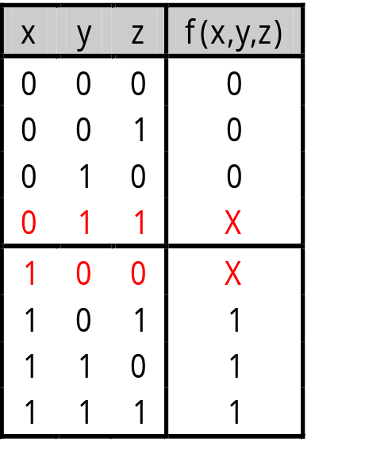
Don’t Care Conditions
The designer is free to change the don’t care option to either 1 or 0 to produce the simplest output.
X’YZ has been changed to 0 and XY’Z’ has been changed to 1 to form a Quad. [a Quad means minimization of two variables]
The changes of X to 0 or 1 is made to produce the best K-map looping.
 | Z’ | Z
X’Y’ | 0 | 0
X’Y | 0 | X
XY | 1 | 1
XY’ | X | 1
 | Z’ | Z
X’Y’ | 0 | 0
X’Y | 0 | 0
XY | 1 | 1
XY’ | 1 | 1

Slide 16
A Realistic Example
Lets design a logic circuit to control the elevator door in a three-story building.
M is a controller signal that represents moving (M=1) and stopped (M=0).
F_{1,} F_{2,} F₃ represents the floor 1, 2 and 3. When the elevator is lined up with the level the corresponding F_{i} is 1.

Slide 17
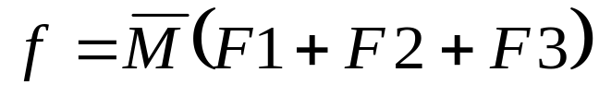
Realistic Example
 | F₂’ F₃’ | F₂’ F₃ | F₂F₃ | F₂F₃’
M’F₁’ | 0 | 1 | X | 1
M’F₁ | 1 | X | X | X
MF₁ | 0 | X | X | X
MF₁’ | 0 | 0 | X | 0
 | F₂’ F₃’ | F₂’ F₃ | F₂F₃ | F₂F₃’
M’F₁’ | 0 | 1 | 1 | 1
M’F₁ | 1 | 1 | 1 | 1
MF₁ | 0 | 0 | 0 | 0
MF₁’ | 0 | 0 | 0 | 0

Slide 18
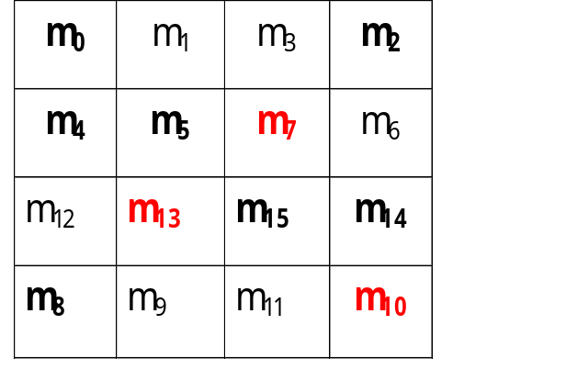
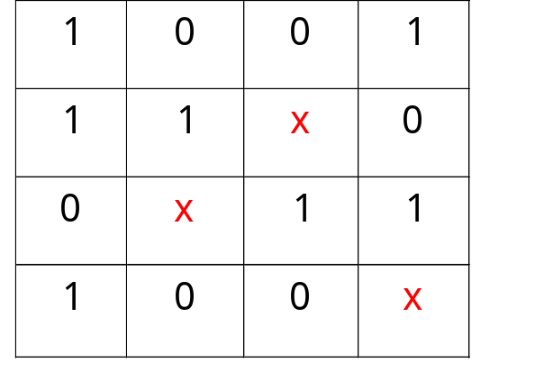
Practice Example
Find a MSP for
f(w,x,y,z) = Σm(0,2,4,5,8,14,15), d(w,x,y,z) = Σm(7,10,13)
This notation means that input combinations wxyz = 0111, 1010 and 1101 (corresponding to minterms m₇, m₁₀ and m₁₃) are unused.

Slide 19

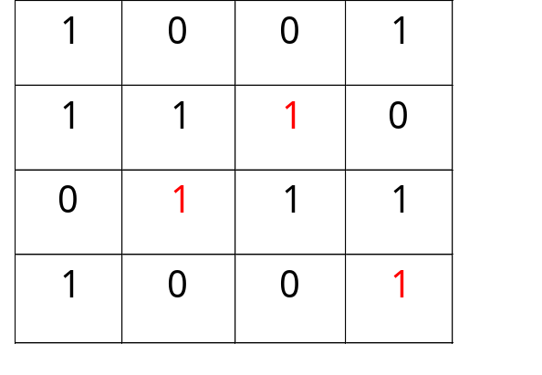
Practice Example
Find a MSP for
f(w,x,y,z) = Σm(0,2,4,5,8,14,15), d(w,x,y,z) = Σm(7,10,13)
This notation means that input combinations wxyz = 0111, 1010 and 1101 (corresponding to minterms m₇, m₁₀ and m₁₃) are unused.

Slide 20
K-map vs Algebraic Simplification
K-map more orderly process with well defined steps compared to algebraic simplification.
  The result is a MSP/MPS, which leads to a minimal two-level circuit
  It’s easy to handle don’t-care conditions
  K-maps are really only good for manual simplification of small expressions.
Need fewer steps and produces the minimum expression.
Things to keep in mind:
  Remember the correct order of minterms/maxterms on the K-map
  When grouping, you can wrap around all sides of the K-map, and your groups can overlap
  Make as few rectangles as possible, but make each of them as large as possible. This leads to fewer, but simpler, product terms
  There may be more than one valid solution

Slide 21
Parity generators

Slide 22
Parity bit for error Detection
Used to detect whether the number of 1s in the input is even or odd, indicated by a parity bit
Used for detecting errors in the received data
Two types:
Even parity – Parity bit -> high, when 1s -> odd. Makes total number of 1s even in the set
Odd Parity – Parity bit -> high, when 1s ->even. Makes total number of 1s odd in the set

Slide 23
Parity bit
By your knowledge so far, along with new information, what do you think is the basic parity generator? And what type?
How parity bits are used (Even Parity):
1 | 0 | 0 | 1 | 1 | 1 | 1 | 1 | 0 | 1 | 1 | 0
PARITY BIT
DATA

Slide 24
Odd Parity truth table
For an odd parity generator with three inputs and one output, the truth table is
X | Y | Z | P
0 | 0 | 0 | 1
0 | 0 | 1 | 0
0 | 1 | 0 | 0
0 | 1 | 1 | 1
1 | 0 | 0 | 0
1 | 0 | 1 | 1
1 | 1 | 0 | 1
1 | 1 | 1 | 0

Slide 25
K-map for Odd Parity
K-Map for Odd Parity Generator
Y’Z’
Y’Z
YZ
YZ’
1 | 0 | 1 | 0
0 | 1 | 0 | 1
X’
X
P = X’Y’Z’ + XY’Z + X’YZ +XYZ’

